Slide 1
Group activity (2hs)
6–8 people per team (odd numbers welcome, odd behavior optional)
Cross-pollinate: spread out across research groups
Elect a team captain — sorry, group leaders are coach, not captain
Notes:
Thank you to the panelists for dedicating their time. In our opinion it is important to get everyone to come to the table, male and female. Moreover thank you very much to everyone in the room who have come, it is really great to see so many people take time out of their busy days to recognise that this is an important topic that needs to be discussed.
We first want to

Slide 2
Good Teams, Great Environment, Excellent Science

Slide 3
Pre-Session Agreement
The aim is to have a constructive and positive discussion. Therefore we agree to discuss openly and honestly.
At the same time, we understand that this is a discussion of ideas in real time, and necessarily answers will not be fully polished. We will therefore not hold ourselves to an unrealistic standard and instead aim to have a constructive discussion.
Remember, we are all on the same page in wanting to improve our culture and practices at work
Notes:
Thank you to the panelists for dedicating their time. In our opinion it is important to get everyone to come to the table, male and female. Moreover thank you very much to everyone in the room who have come, it is really great to see so many people take time out of their busy days to recognise that this is an important topic that needs to be discussed.
We first want to

Slide 4
Ground rules for today
Assume good intent; focus on impact.
“Ouch/Oops”: it’s fine to course-correct in real time
Discuss ideas, patterns, not people.
Notes:
Thank you to the panelists for dedicating their time. In our opinion it is important to get everyone to come to the table, male and female. Moreover thank you very much to everyone in the room who have come, it is really great to see so many people take time out of their busy days to recognise that this is an important topic that needs to be discussed.
We first want to

Slide 5
Is Yair a mind reader?
Think on a male scientist (not from MPIP)?
2. Think on a female scientist (not from MPIP)?
Notes:
Thank you to the panelists for dedicating their time. In our opinion it is important to get everyone to come to the table, male and female. Moreover thank you very much to everyone in the room who have come, it is really great to see so many people take time out of their busy days to recognise that this is an important topic that needs to be discussed.
We first want to

Slide 6
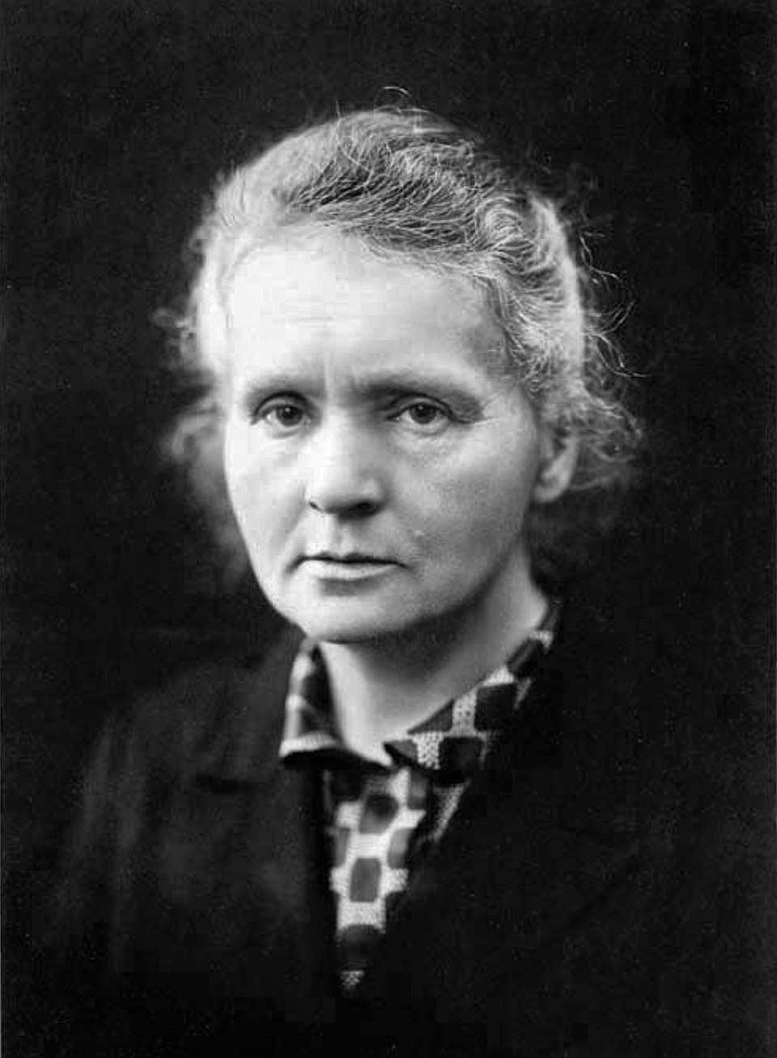
Is this the person you had in mind?
Maria Skłodowska-Curie
Notes:
Thank you to the panelists for dedicating their time. In our opinion it is important to get everyone to come to the table, male and female. Moreover thank you very much to everyone in the room who have come, it is really great to see so many people take time out of their busy days to recognise that this is an important topic that needs to be discussed.
We first want to

Slide 7

What colour do you see?
Sometimes knowing your biases is not enough enough to overcome it. It just the first step …
Notes:
Thank you to the panelists for dedicating their time. In our opinion it is important to get everyone to come to the table, male and female. Moreover thank you very much to everyone in the room who have come, it is really great to see so many people take time out of their busy days to recognise that this is an important topic that needs to be discussed.
We first want to

Slide 8
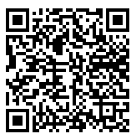
Activity #1: Unconscious bias
Prepare one slide to explain the assigned task to the group (1 minute presentation).
Prepare one slide to illustrate situations where this bias might occur in academic settings (1 minute presentation)
Notes:
Thank you to the panelists for dedicating their time. In our opinion it is important to get everyone to come to the table, male and female. Moreover thank you very much to everyone in the room who have come, it is really great to see so many people take time out of their busy days to recognise that this is an important topic that needs to be discussed.
We first want to

Slide 9
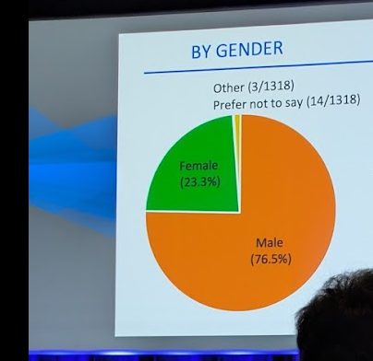
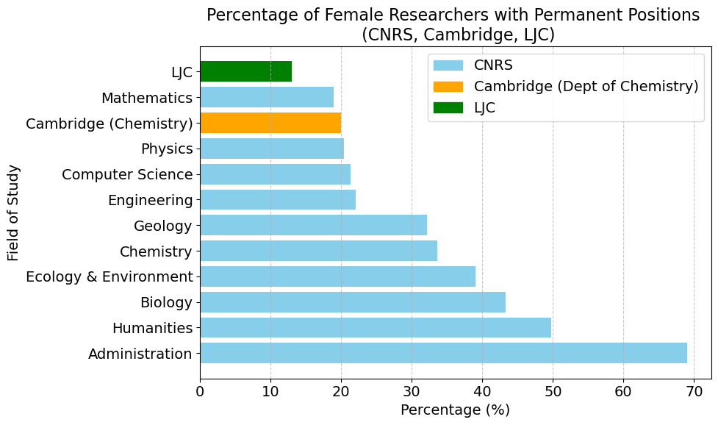
Diversity in academic environments
(Gender is the simplest metric to measure and discuss)
Proportion of female scientists at Psi-k conference
Proportion of female scientists with permanent positions at CNRS
Notes:
Thank you to the panelists for dedicating their time. In our opinion it is important to get everyone to come to the table, male and female. Moreover thank you very much to everyone in the room who have come, it is really great to see so many people take time out of their busy days to recognise that this is an important topic that needs to be discussed.
We first want to

Slide 10
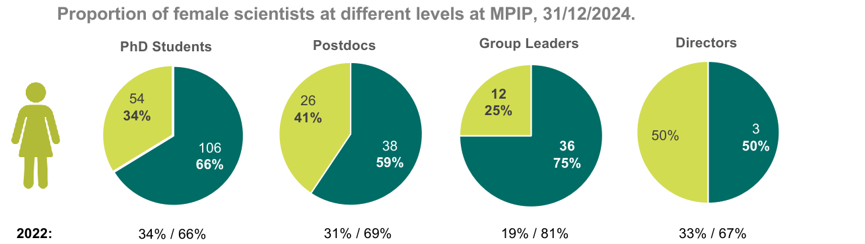
Gender diversity at MPIP
Source: Naurod GL retreat, 2025
Notes:
Thank you to the panelists for dedicating their time. In our opinion it is important to get everyone to come to the table, male and female. Moreover thank you very much to everyone in the room who have come, it is really great to see so many people take time out of their busy days to recognise that this is an important topic that needs to be discussed.
We first want to

Slide 11
Activity #2: Inclusion in Academia
Discuss within your group the list of statements and classify them.
Pick one statement, and a representative to summarize the group discussion on that point.
Notes:
Thank you to the panelists for dedicating their time. In our opinion it is important to get everyone to come to the table, male and female. Moreover thank you very much to everyone in the room who have come, it is really great to see so many people take time out of their busy days to recognise that this is an important topic that needs to be discussed.
We first want to

Slide 12
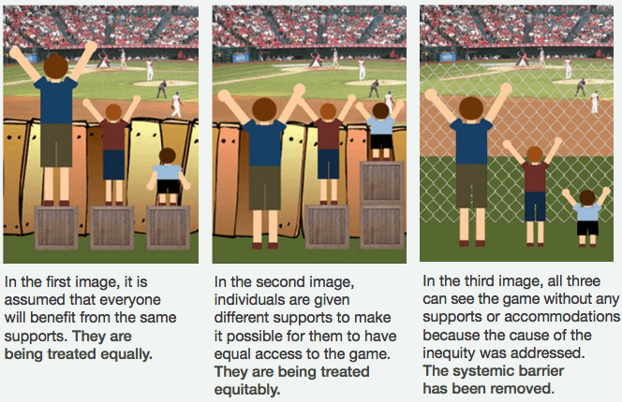
Equality, Equity and Inclusion
Notes:
Thank you to the panelists for dedicating their time. In our opinion it is important to get everyone to come to the table, male and female. Moreover thank you very much to everyone in the room who have come, it is really great to see so many people take time out of their busy days to recognise that this is an important topic that needs to be discussed.
We first want to

Slide 13

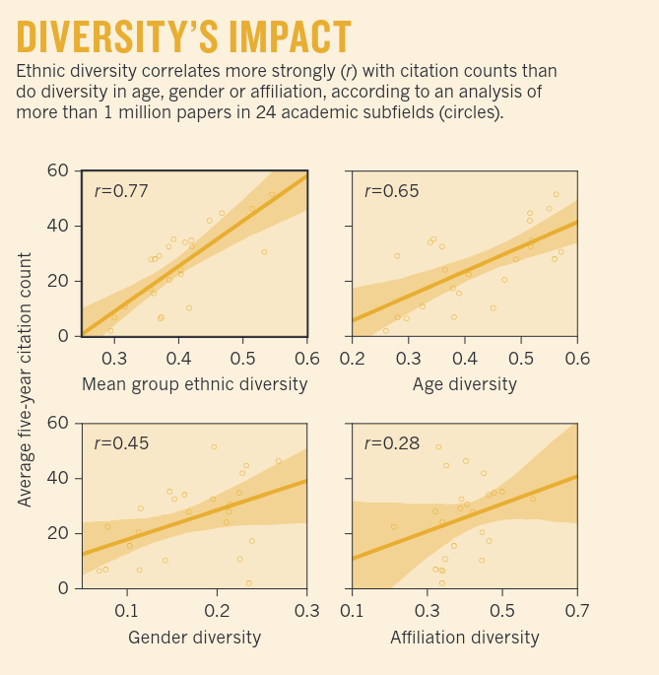
Diversity increases innovation
Enlarges changes and improves areas of study
Explore the full pool of talent available to capitalize on
And …
Analysis of more than 1 million papers in 24 academic subfields in the United States, United Kingdom, Canada and Australia
Powell, K. Nature 558, 19-22 (2018)
Notes:
Making places more inclusive benefits not only gender equality but also many other facets of society..
For all questions we want 50:50 panelists experience and then suggestions/thoughts on what to improve/not to improve
Possible questions: - opinions? - does your personal experience reflect this?

Slide 14

Six principles
Use universal design
Maximize each individual potential
Take a different perspective
Be alert and be willing to change
Try things out
Hold people accountable
Notes:
Thank you to the panelists for dedicating their time. In our opinion it is important to get everyone to come to the table, male and female. Moreover thank you very much to everyone in the room who have come, it is really great to see so many people take time out of their busy days to recognise that this is an important topic that needs to be discussed.
We first want to

Slide 15
Use universal design
“Not just for people with disabilities — it benefits everyone.”
“Not an afterthought — it’s part of the design from the beginning.”
“Not about lowering standards — it’s about removing unnecessary barriers.”
Universal Design shifts the focus from “fixing individuals” to fixing systems
Examples at MPIP (food for thought for Thursday discussion)
Notes:
Thank you to the panelists for dedicating their time. In our opinion it is important to get everyone to come to the table, male and female. Moreover thank you very much to everyone in the room who have come, it is really great to see so many people take time out of their busy days to recognise that this is an important topic that needs to be discussed.
We first want to

Slide 16
Activity #3: What if …
Discuss the provided situations within your group.
A representative will be asked to summarize your group’s discussion, no slides this time ;).
Notes:
Thank you to the panelists for dedicating their time. In our opinion it is important to get everyone to come to the table, male and female. Moreover thank you very much to everyone in the room who have come, it is really great to see so many people take time out of their busy days to recognise that this is an important topic that needs to be discussed.
We first want to

Slide 17
Instruction: Discuss the following situations with your group
Situations:
Lab “PPE Help” A colleague repeatedly “adjusts” another person’s lab coat and goggles, touching their waist/shoulder without asking.
Compliments Creep An office-mate regularly comments on your clothes/body “as a compliment,” especially when others aren’t around.
Note-Taker by Default In meetings, the same woman/international colleague is asked to take notes “because you’re organized.”
Food & Drink Pressure At a social, a colleague teases someone who declines alcohol or certain foods for cultural/religious reasons.
Access Shrug Colleagues refuse to use the mic (“we can all hear”), though a peer has said they have hearing difficulty.
Notes:
Thank you to the panelists for dedicating their time. In our opinion it is important to get everyone to come to the table, male and female. Moreover thank you very much to everyone in the room who have come, it is really great to see so many people take time out of their busy days to recognise that this is an important topic that needs to be discussed.
We first want to

Slide 18
Slack/WhatsApp Meme
A sexual joke/meme is posted in the lab group chat; a few react with emojis, the target goes silent.
Teaching/TA Line Crossed
A TA messages a student late at night with flirty comments tied to grading/extra-credit opportunities.
Fieldwork/Travel Pressure
On a trip, a team lead suggests sharing a room “to save budget,” then pushes for drinks; a junior feels they can’t refuse.
CSV Surgery
You walk by and see a colleague deleting three “bad” rows in raw.csv and saving over the original.
Notes:
Thank you to the panelists for dedicating their time. In our opinion it is important to get everyone to come to the table, male and female. Moreover thank you very much to everyone in the room who have come, it is really great to see so many people take time out of their busy days to recognise that this is an important topic that needs to be discussed.
We first want to

Slide 19
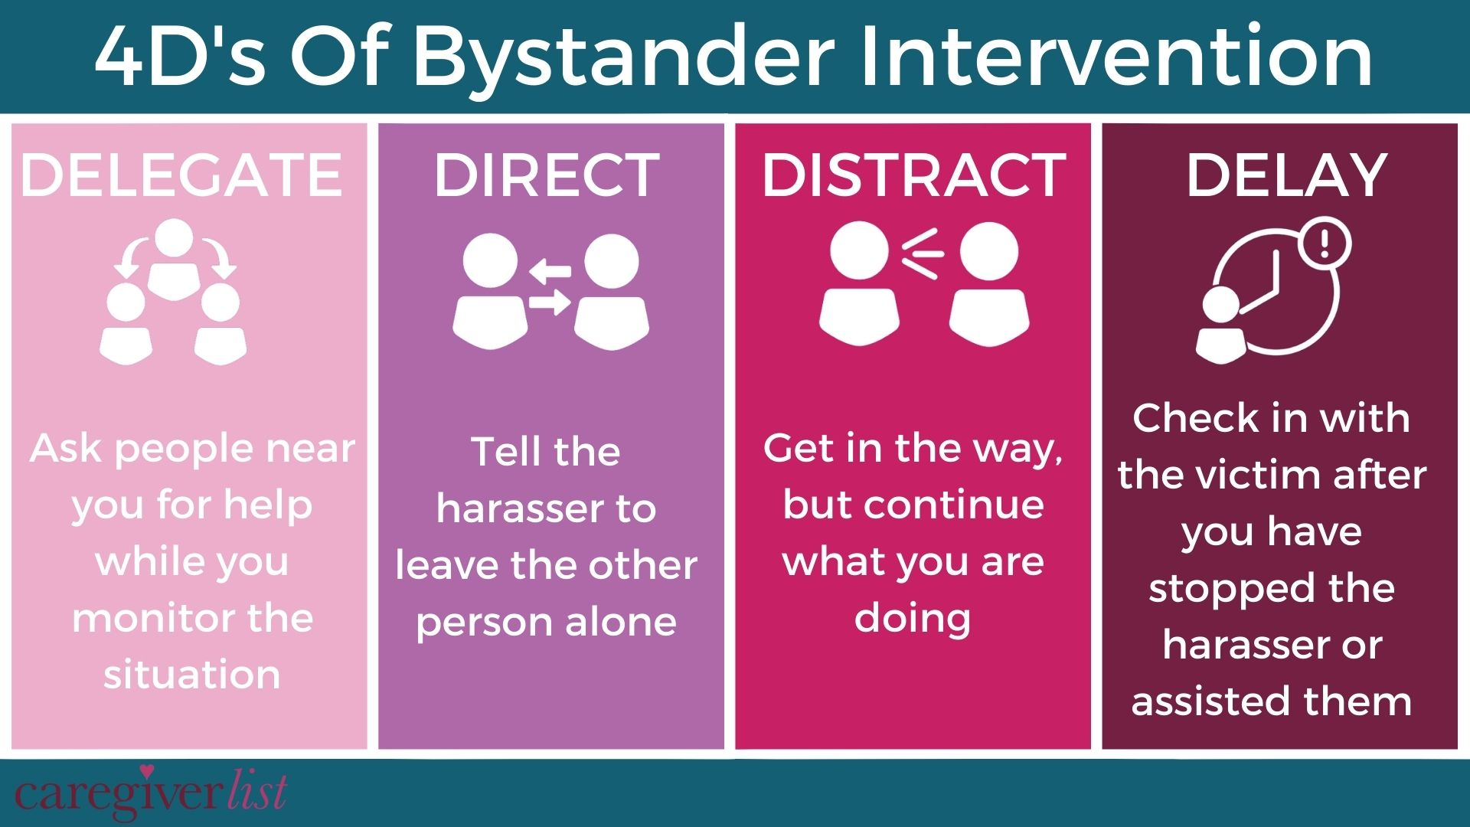
Notes:
Thank you to the panelists for dedicating their time. In our opinion it is important to get everyone to come to the table, male and female. Moreover thank you very much to everyone in the room who have come, it is really great to see so many people take time out of their busy days to recognise that this is an important topic that needs to be discussed.
We first want to

Slide 20

Notes:
Thank you to the panelists for dedicating their time. In our opinion it is important to get everyone to come to the table, male and female. Moreover thank you very much to everyone in the room who have come, it is really great to see so many people take time out of their busy days to recognise that this is an important topic that needs to be discussed.
We first want to

Slide 21

Notes:
Thank you to the panelists for dedicating their time. In our opinion it is important to get everyone to come to the table, male and female. Moreover thank you very much to everyone in the room who have come, it is really great to see so many people take time out of their busy days to recognise that this is an important topic that needs to be discussed.
We first want to

Slide 22
Feedback/after activity thoughts (Sep-2025, AK-bonn retreat): - explain better that those are hypothetical situations are used as an excuse, so play along - explain clearer to the group captain to not share instructions. - CV tasks were a bit unclear - access to the slides got a bit clumsy
Rework the what if situations (try to find real examples)
Psychological harassment or mobbing (https://www.epfl.ch/about/respect/what-is-harassment/psychological-harassment-or-mobbing/)
Make sure groups are diverse (swap people, and natural leaders)
Prepare some notes for the debrief (particularly for the situations, activity 3).
Notes:
Thank you to the panelists for dedicating their time. In our opinion it is important to get everyone to come to the table, male and female. Moreover thank you very much to everyone in the room who have come, it is really great to see so many people take time out of their busy days to recognise that this is an important topic that needs to be discussed.
We first want to

